Slide 1

Software Engineering
Lecture 1: Introduction & Industrial Approach to Problem Solving
Course: ITIT-3103 Software Engineering | Department: Information Technology
Institution: ABV-IIITM Gwalior | Instructor: Dr. Dheeraj Kodati

Slide 2
About Speaker
Education
🎓 Ph.D. in Computer Science & Engineering
National Institute of Technology (NIT) Warangal
Specialization: Natural Language Processing (NLP) and Large Language Models (LLMs)
🎓 M.S. in Computer Science
University of Central Missouri, USA
Professional Experience & Research
11+ years of experience across:
  Software Industry, Research & Development and Academia
DAAD Postdoctoral Fellow
University of Hamburg, Germany
Research areas:
  Natural Language Processing
  Generative AI & Large Language Models
  Explainable Deep Learning
  Bioinformatics
Published research in reputed journals and A* international conferences
Dr. Dheeraj Kodati
Assistant Professor
Department of Information Technology
ABV-IIITM Gwalior

Slide 3
Learning Objectives
Understand why Software Engineering is required in modern technological landscapes.
Explore the historical context and implications of the Software Crisis.
Differentiate between unstructured programming and formal software engineering.
Identify industrial development challenges and characteristics of quality software.
Understand the SDLC, stakeholder management, and fundamental SE principles.

Slide 4

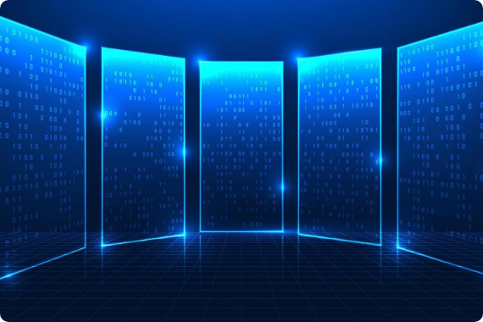
Why Do We Need Software Engineering?
Software powers critical infrastructure and everyday applications across society:
•
Online Banking & UPI Payments
•
Aadhaar Infrastructure & IRCTC
•
Amazon, Google Maps & WhatsApp
•
Healthcare Systems & Air Traffic Control
Real-world Scale: Building an application like WhatsApp for billions of users requires structured planning, continuous maintenance, and security—beyond basic code writing.

Slide 5
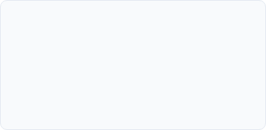
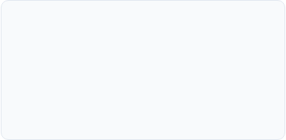
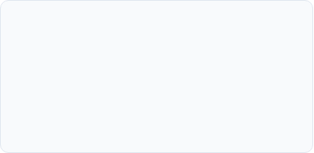

What is Software?
Software is far more than just executable code. It is a complete engineered product.
Executable Elements
Associated Artifacts
Ecosystem & Data
Source programs, compiled binaries, scripts, and runtime configuration files.
Technical documentation, user manuals, design specs, and test cases.
Databases, installation packages, cloud deployment scripts, and update patches.

Slide 6
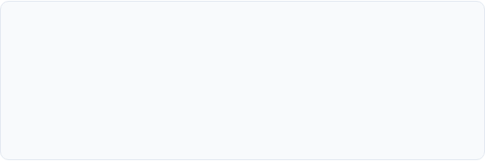
What is Software Engineering?
IEEE Definition
Core Shift
Software Engineering is the systematic, disciplined, and measurable approach to the development, operation, and maintenance of software.
Moving away from ad-hoc "hacking" or simple programming towards an engineering paradigm emphasizing planning, rigorous analysis, structured design, and quality verification.

Slide 7
Programming vs Software Engineering
Dimension | Programming | Software Engineering
Primary Focus | Writing code & logic implementation | Complete software lifecycle & scalability
Team Structure | Individual or small hobbyist task | Collaborative multi-team enterprise activity
Scale & Users | Small scripts, local apps, few users | Distributed systems, millions of users
Documentation | Minimal or non-existent | Comprehensive technical & user documentation

Slide 8
Software Industry Problems & Crisis
Common Industrial Failures
The 1960s Software Crisis
•
Unclear requirements and poor upfront planning
Rapid hardware growth led to unmanageable software complexity, frequent project failures, and massive cost blowouts. This critical bottleneck gave birth to Software Engineering as a formal discipline.
•
Severe budget overruns and missed deadlines
•
Communication gaps between stakeholders
•
High defect density and security vulnerabilities

Slide 9
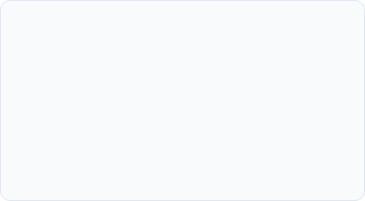
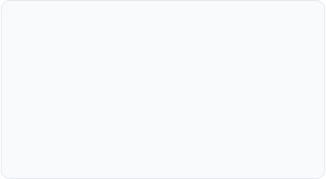
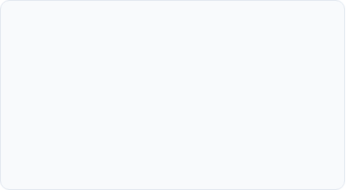



How Software Engineering Solves Problems
Standardized Processes
Quality Assurance
Tools & Governance
Defined workflows like SDLC phases to ensure systematic progression from idea to delivery.
Rigorous testing strategies, automated CI/CD pipelines, and robust code reviews.
Version control systems, requirement traceability matrices, and maintenance planning.

Slide 10
Software Development Life Cycle (SDLC)
Requirements Gathering: Understand customer needs and system specifications.
Analysis & Design: Structure system architecture, data models, and UI/UX.
Implementation: Write clean, modular, and maintainable source code.
Testing & Deployment: Verify functionality, performance, and release to production.
Maintenance: Continuous updates, bug fixes, and feature enhancements.

Slide 11
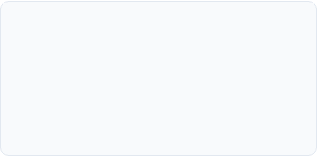
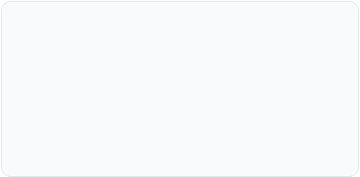
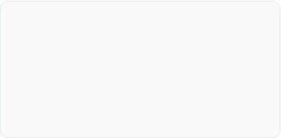

Characteristics of Good Software
Reliable & Efficient
Secure & Scalable
Maintainable
Performs consistently without crashing, utilizing optimal CPU and memory resources.
Protects user data against breaches and seamlessly handles growing user loads.
Structured cleanly so future developers can easily update and refactor code.

Slide 12
Industrial Case Studies
Amazon Scale
Core Banking Systems
Handles millions of concurrent transactions, global warehouses, and real-time AI recommendations. Achieved through rigorous distributed system design and microservices.
Requires flawless transactional integrity, absolute regulatory compliance, multi-layer encryption, and zero downtime across global nodes.

Slide 13
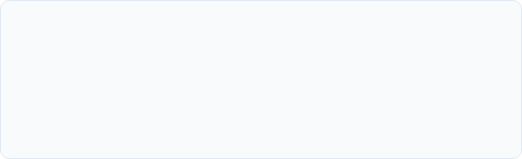
Principles & Modern Paradigm
Fundamental Principles
Modern Engineering Practices
Divide and Conquer, Abstraction, Modularity, Reusability, Simplicity, and Incremental Development.
Agile methodologies, DevOps automation, Continuous Integration / Continuous Deployment (CI/CD), and Cloud-native microservices.

Slide 14
Lecture Summary
Software engineering transforms complex societal problems into reliable digital solutions.
It evolved directly from the 1960s Software Crisis to curb project failures and cost blowouts.
Distinguishes itself from simple programming through systematic lifecycles and governance.
Emphasizes high maintainability, rigorous testing, and scalable architecture.

Slide 15
Questions?
Thank you for your attention and active participation.
"Software Engineering is not just about writing code—it is about building reliable, maintainable, and scalable software systems that solve real-world problems."
ABV-IIITM Gwalior | Department of Information Technology

Slide 16

Image Sources
https://static.vecteezy.com/system/resources/previews/078/759/349/non_2x/technology-background-digital-screen-with-running-code-and-data-streams-representing-software-development-programming-coding-process-system-engineering-and-modern-digital-technology-innovation-vector.jpg
Source: www.vecteezy.com

